Slide 1
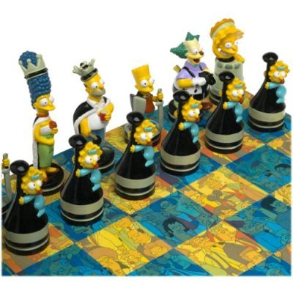
Chess AI’s, How do they work?
Math Club 10/03/2011

Slide 2
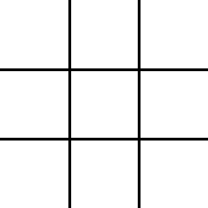
Tic Tac Toe

Slide 3
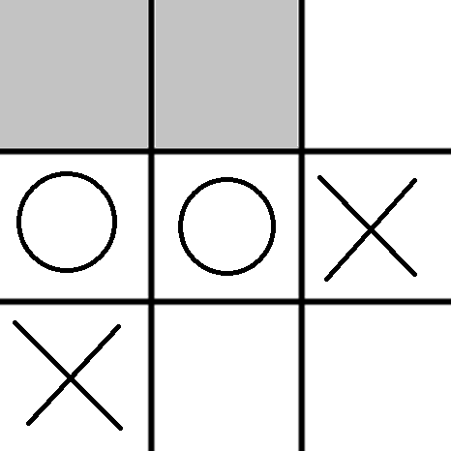
What is the best move for X?

Slide 4

Minimax Algorithm
Give the game a positive score if White is winning, negative score if Black is winning.
White does all he can to make the score positive.
Black does all he can do make the score negative.
White knows that black is doing all he can to make the score negative
Etc…

Slide 5
Can we … minimax … it?

Slide 6
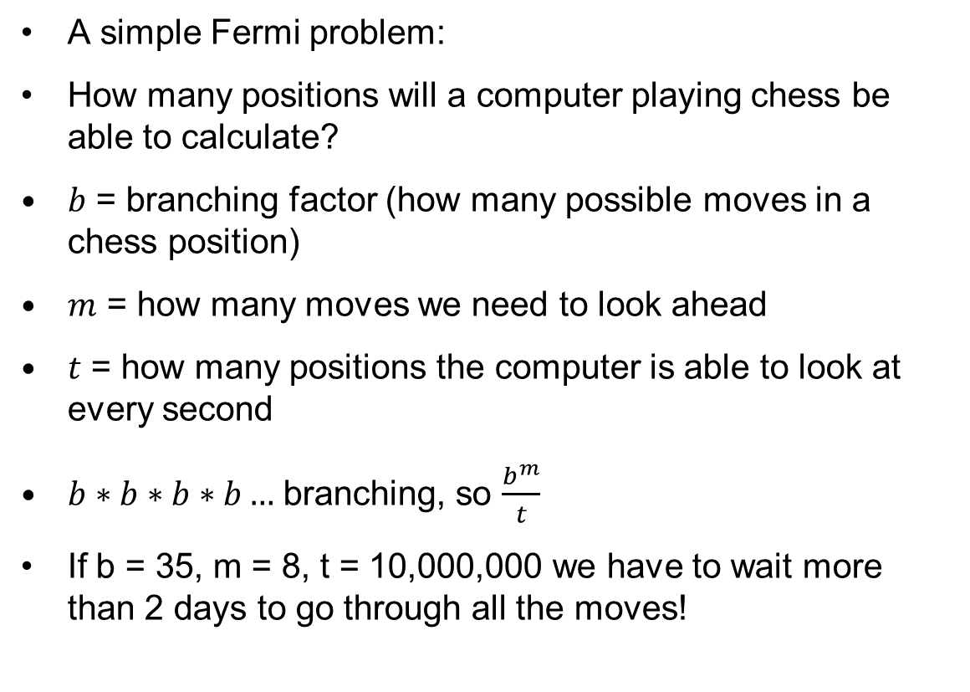
But chess is more complicated!
A simple Fermi problem:
How many positions will a computer playing chess be able to calculate?
$b$ = branching factor (how many possible moves in a chess position)
$m$ = how many moves we need to look ahead
$t$ = how many positions the computer is able to look at every second
$b∗b∗b∗b…$ branching, so $\frac{b^{m}}{t}$
If b = 35, m = 8, t = 10,000,000 we have to wait more than 2 days to go through all the moves!

Slide 7

Heuristics!
Heuristics are simple strategies that the computer can use to “approximate” things.
Example: if you can take a piece with a pawn, then always do so.
Caution: simple heuristics like these can lead to very bad moves.

Slide 8
Alpha-Beta Heuristic
This heuristic usually reduces time and doesn’t do any worse than searching everything.
Basically, we look at the better moves first.
If we find a move worse than one we already looked at, we look at something else.

Slide 9
Alpha-Beta
Suppose we find a really good move, A, so that no matter what they do, we have an advantage by the third move.
Next we find some other move B, where the is some move they can make that neutralizes the position by the third move.
Clearly B is inferior to A, so we can stop searching entirely.

Slide 10
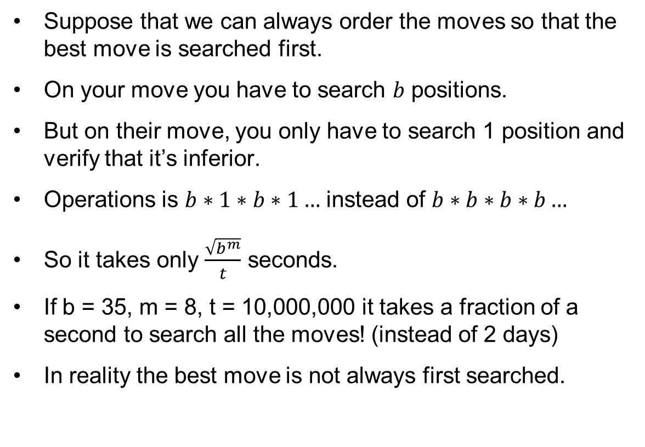
How far can we go now?
Suppose that we can always order the moves so that the best move is searched first.
On your move you have to search $b$ positions.
But on their move, you only have to search 1 position and verify that it’s inferior.
Operations is $b∗1∗b∗1…$ instead of $b∗b∗b∗b…$
So it takes only $\frac{\sqrt{b^{m}}}{t}$ seconds.
If b = 35, m = 8, t = 10,000,000 it takes a fraction of a second to search all the moves! (instead of 2 days)
In reality the best move is not always first searched.

Slide 11
Horizon Effect
You play QxP, giving yourself a good score believing that you won a pawn.
But one move after the “horizon”, you don’t see PxQ, which loses you a queen.
Solution: quiescence search – at the end of the search tree, only consider “quiet” moves.

Slide 12
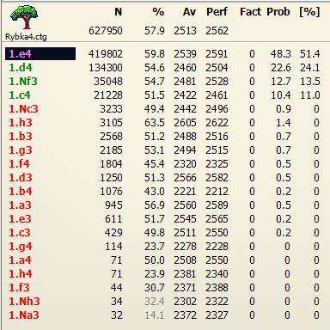
Opening Books
For the start of the game, the computer already has prepared a set of opening moves – so it doesn’t have to search in the opening.

Slide 13
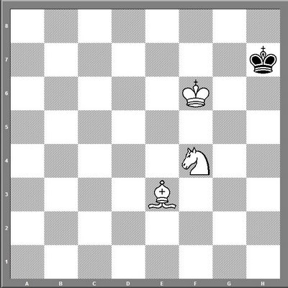
Endgame Tablebases
Use brute force to prepare a database of endgame positions and their optimal responses, so you can play perfectly if there are few enough pieces left.

Slide 14
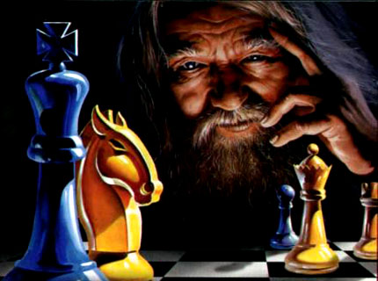
Challenge
Survive for as long as possible against Chessmaster.

